Slide 1

CIS 200 Final Review

Slide 2
New Material

Slide 3
Data Structures

Slide 4
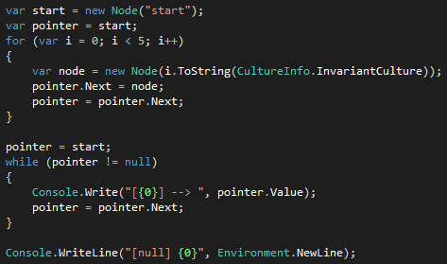
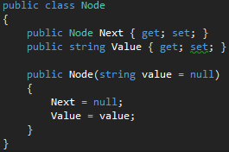

Linked List

Slide 5
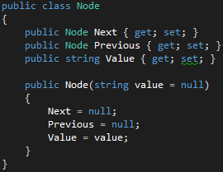
Doubly Linked List

Slide 6
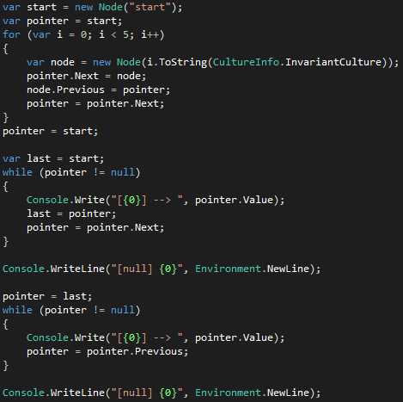
Doubly Linked List

Slide 7

Doubly Linked List

Slide 8
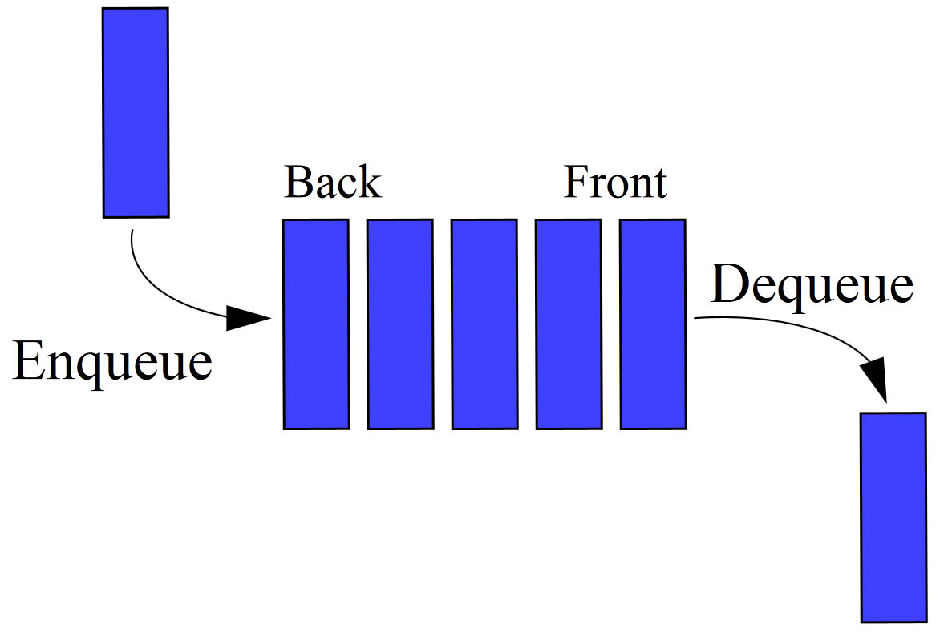
Queue

Slide 9
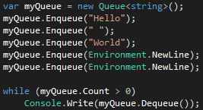

Queue

Slide 10
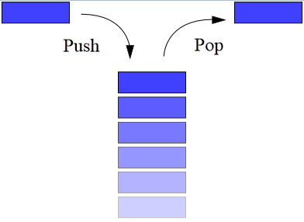
Stack

Slide 11
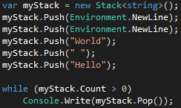

Stack

Slide 12
Test 01 Material

Slide 13
Memory Management
C, C++ - Have to “allocate” memory
Forgetting to “free” results in memory leaks
“Garbage Collector” Rounds up and “reclaims” memory
Variables that drop out of “scope” will be collected
Temporary values inside methods reclaimed on method exit
Generally uncontrolled by the developer

Slide 14
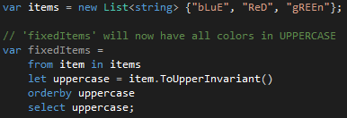
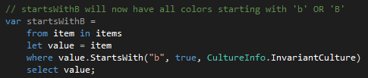
LINQ Language Integrated Query
Perform Queries Against Objects, Data

Slide 15
LINQ Keywords
“from” - Data Source
“where” – Filters the source elements with Boolean expressions
“select” – Choosing the data type to work with
“group” – Groups results according to a desired key value
“orderby” – Sorts the query results in ascending or descending order based on a comparer
“let” – Introduce a variable for query use

Slide 16
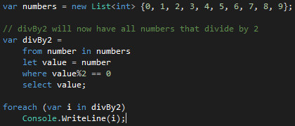
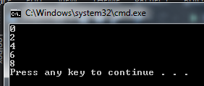

Slide 17
Namespaces, Scope
Classes, often with common functionality, bundled together
System.Console
System.Collections.Generic
System.Linq
Scope
“private” – Can only be accessed by the class, object itself
“protected” – Can only be accessed by the class, object, or any child classes, objects
“public” – Available access for all

Slide 18
Constructors
C#, .NET compiler provides a ‘free’ constructor
No parameters
When a new constructor is created, ‘free’ constructor goes away
Constructors can be “connected” with “this”

Slide 19
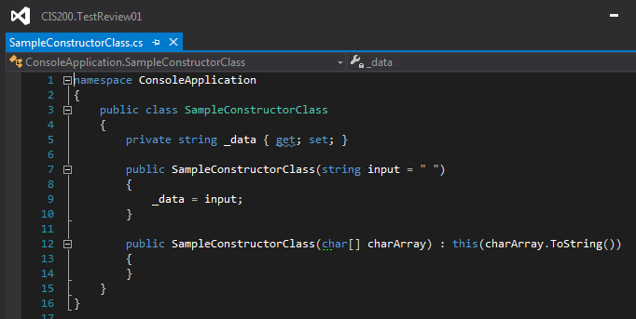

Slide 20
Interfaces
Object used for creating “interfaces”, common code
Classes “include” an interface
All methods, properties are “abstract” in an interface
Objects that implement interface can be grouped
List<IPayable>
IPayable, IDisposable, etc

Slide 21
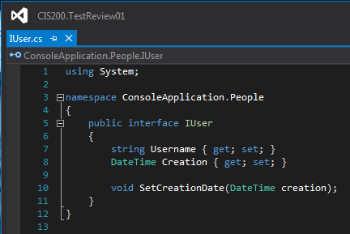

Slide 22
Inheritance
Classes with child or children classes
Can be used to “share” common code properties
Allows for “unique” objects, while reducing code
Object -> Person -> Student
Object -> Person -> Employee

Slide 23
Inheritance Keywords
“abstract” – Methods marked MUST be overridden
Class declared with abstract prevents creation with “new”
“virtual” – Methods marked CAN be overridden
Controls “how” other classes inherit information from the class
Private, protected, public – Used to control what is inheritance

Slide 24
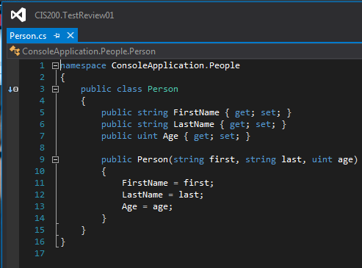
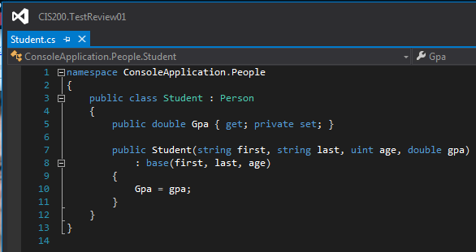

Slide 25
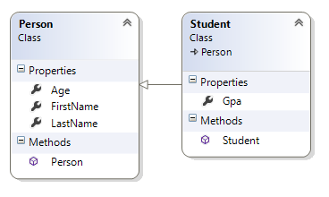

Slide 26
Casting
Convert one type to another
Integer to String
Decimal to Integer
Byte to Integer
C#, .NET will know how to “box” and “unbox” types
Decimal -> Object -> Integer
Remember back to the Person – Student relationship
We can “cast” Person to Student both ways

Slide 27

Will cast to student just fine
Will compile,
But will throw an EXCEPTION at runtime

Slide 28
Exceptions and Exception Handling
Exceptions are…
“Exceptional” events
Unexpected events, errors during runtime
Unhandled exceptions? Stack trace and application death
Handled with try/catch/finally blocks
Try block “attempts” to run the code in question
Catch block handles the exception(s) that may occur
Finally block, optional, always executes

Slide 29
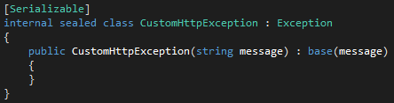

Slide 30
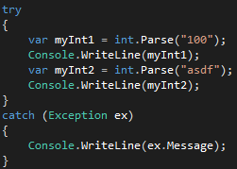

Slide 31
Test 02 Material

Slide 32
Windows Forms, GUI Programming
Elements
Textboxes
Tab Groups
Checkboxes
Fields
Event Handlers
Visual Studio Designer

Slide 33

Event Handlers
“Events” triggered by end user
Button Press
Key Press
Field Entry
…other GUI modifications or events

Slide 34
Files and Streams
Files
Objects on Disks
Streams
Data structure that exposes
Read
Write
Synchronous
Asynchronous

Slide 35
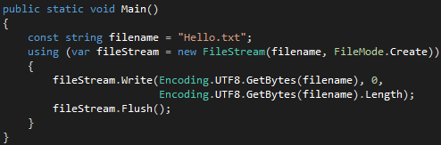
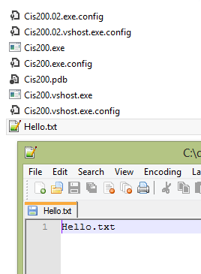
Write to File

Slide 36
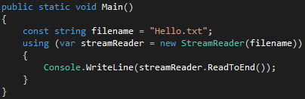

Read from File

Slide 37
Recursion
…a solution strategy that involves a simpler version of the same problem. The problem becomes simplified with each call until we reach a stopping point. Resolution level by level.
Useful for
Complex equations (Fibonacci number)
Towers of Hanoi
Binary Searching
Entry point
Stopping point

Slide 38
Define a Recursion Method
What is my base case?
What is the solution to my base case?
What is my intermediate case?
What is the solution to the intermediate case?

Slide 39
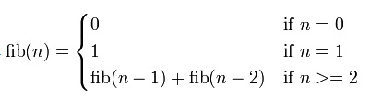
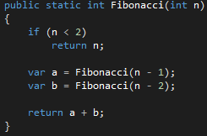
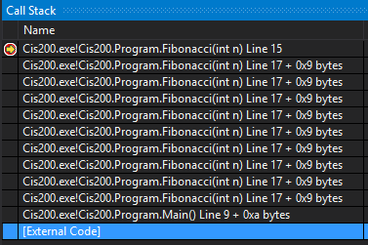
Recursion Example

Slide 40
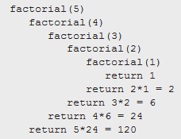
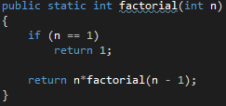
Recursion Example

Slide 41
Big O
What’s better?
T(N) = 2 * N * N
… 2(N^2)
T(N) = 1 * N * N + 1 * N
… N^2 + N

Slide 42
Sample Questions from Blackboard Wiki

Slide 43
What is the differences between Panel and GroupBox?
Panel
Scrollable
Does not have a caption
Groupbox
Not scrollable
Has a caption

Slide 44
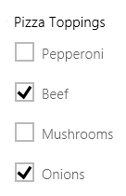

What is the differences between CheckBox and RadioButton?
CheckBox
Offer a “binary” choice
Turn options on / off
True / False
Multiple together
RadioButton
Two or more mutually EXCLUSIVE items
… XOR
Multiple Choice Question

Slide 45
RadioButton controls become a set of mutually exclusive choices. Why?
A group of RadioButtons offer only a single choice to a user
Selecting one will deselect another
Logical XOR

Slide 46
ListBox has four modes of operation, what are they and describe them.
None
No items can be selected
One
Only one item can be selected
MultiSimple
Multiple items can be selected
MultiExtended
Multiple items can be selected AND the user can use SHIFT, CTRL, and ARROw keys to make selections

Slide 47
ComboBox has three modes of operation, name and describe each.
Simple
List is always visible, text portion editable
User can enter a new value
DropDown
List is displayed by clicking down arrow and text portion is editable
User can enter a new value
DropDownList
List is displayed by clicking down arrow and text is not editable
Only values in the list can be selected

Slide 48
How does the use of object serialization compare to simply writing our data to a text file?
Raw Write to Text File
List of “strings”
Will require manual “re-entry” later
Some method, or handler to convert text file to .NET object
Object Serialization
Takes state of object, serializes for storage
Reading serialization produces native .NET object

Slide 49
The hierarchy of data includes what, and in what order?
(Smallest)
Bits
Bytes
Fields
Records
Files
(Largest)

Slide 50
Describe the hierarchy of data elements
Bits
0 or 1
Bytes
8 bits together
Fields
Name, Phone number, Data Diemension
Records
Group of fields
Files
Group of fields or other data

Slide 51

How can REACH further help you today?
Ask Questions Now!
Need to see an Example?
Need to see a concept again?
Need additional help?
Visit us at:
iTech Zone
CRC (Ekstrom Library)
Wednesday & Thursday (12 / 5 - 12 / 6)
9:00AM – 5:00PM
Friday (12 / 7)
9:00AM – 4:00PM

